Slide 1
Introduction to Machine Learning (CS642)
Lecture 01 - Image Classification
Dr. Abdul Basit
Assistant Professor - CSIM University of Balochistan
October 24, 2025
Intro to Mahcine Learning

Slide 2






Contents
1 Overview
2
Image Classification Terminology
3
Challenges
4 Deep learning classification pipeline
5
The four steps
Step 1: Gather Your Dataset
Step 2: Split Your Dataset Step 3: Train your Network Step 4: Evaluate
6 Feature-based Learning versus Deep Learning
Intro to Mahcine Learning

Slide 3
Image classification
For computers, interpreting the contents of an image is less trivial all our computer sees is a big matrix of numbers. It has no idea
regarding the thoughts, knowledge, or meaning the image is trying to convey.
Intro to Mahcine Learning

Slide 4
Image classification
In order to understand the contents of an image, we must apply image classification, which is the task of using computer vision and machine learning algorithms to extract meaning from an image.
This action could be as simple as assigning a label to what the image contains, or as advanced as interpreting the contents of an image and returning a human-readable sentence.
Image classification and image understanding are currently (and will continue to be) the most popular sub-field of computer vision for the next ten years.
Intro to Mahcine Learning

Slide 5


Contents
1 Overview
2
Image Classification Terminology
3
Challenges
4 Deep learning classification pipeline
5
The four steps
Step 1: Gather Your Dataset Step 2: Split Your Dataset Step 3: Train your Network Step 4: Evaluate
6 Feature-based Learning versus Deep Learning
Intro to Mahcine Learning

Slide 6
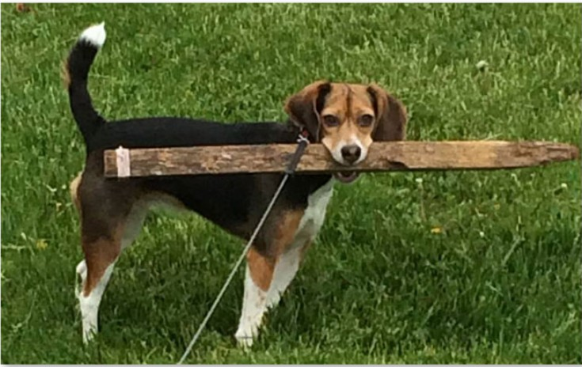
Image classification
Image classification is the task of assigning a label to an image from a predefined set of categories.
let’s assume that our set of possible categories includes:
categories = {cat, dog, panda}
Figure: The goal of an image classification system is to take an input image and assign a label based on a pre-defined set of categories.
Intro to Mahcine Learning

Slide 7
Image classification
More formally, given our input image of W × H pixels with three channels, Red, Green, and Blue, respectively, our goal is to take the W × H × 3 = N pixel image and figure out how to correctly classify the contents of the image.
Intro to Mahcine Learning
7 / 33

Slide 8
Contents
1 Overview
2
Image Classification Terminology
3
Challenges
4 Deep learning classification pipeline
5
The four steps
Step 1: Gather Your Dataset Step 2: Split Your Dataset Step 3: Train your Network Step 4: Evaluate
6 Feature-based Learning versus Deep Learning
Intro to Mahcine Learning
7 / 33

Slide 9
Image classification
Terminology
When performing machine learning and deep learning, we have a dataset we are trying to extract knowledge from.
Each example/item in the dataset (whether it be image data, text data, audio data, etc.) is a data point. A dataset is therefore a collection of data points
1
In the context of image classification, our dataset is a collection of images.
Each image is, therefore, a data point.
2
Intro to Mahcine Learning

Slide 10
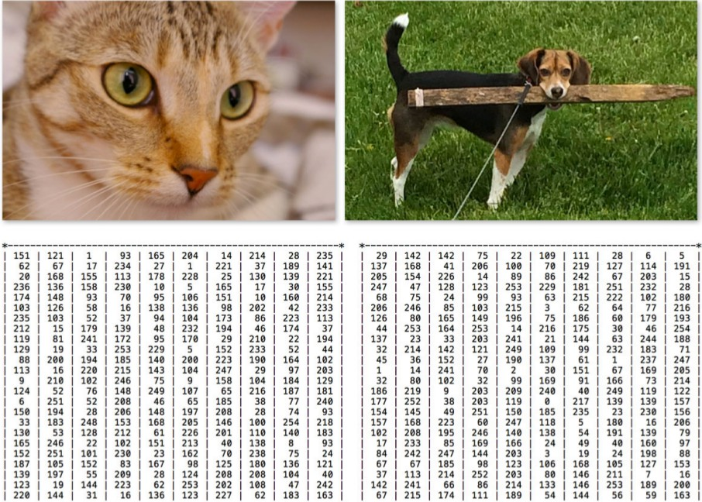
Image classification
Intro to Mahcine Learning

Slide 11

Contents
1 Overview
2
Image Classification Terminology
3
Challenges
4 Deep learning classification pipeline
5
The four steps
Step 1: Gather Your Dataset Step 2: Split Your Dataset Step 3: Train your Network Step 4: Evaluate
6 Feature-based Learning versus Deep Learning
Intro to Mahcine Learning

Slide 12
Image classification
Challenges
Viewpoint variation Scale variation Deformation Occlusion Illumination Background clutter Intra class variation
Intro to Mahcine Learning

Slide 13
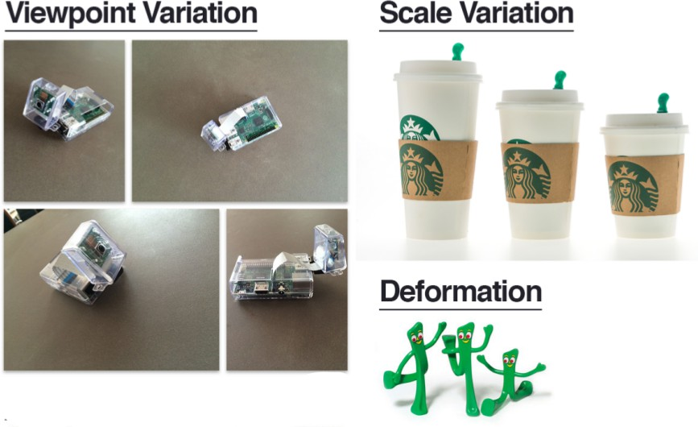
Image classification
Challenges
Intro to Mahcine Learning

Slide 14
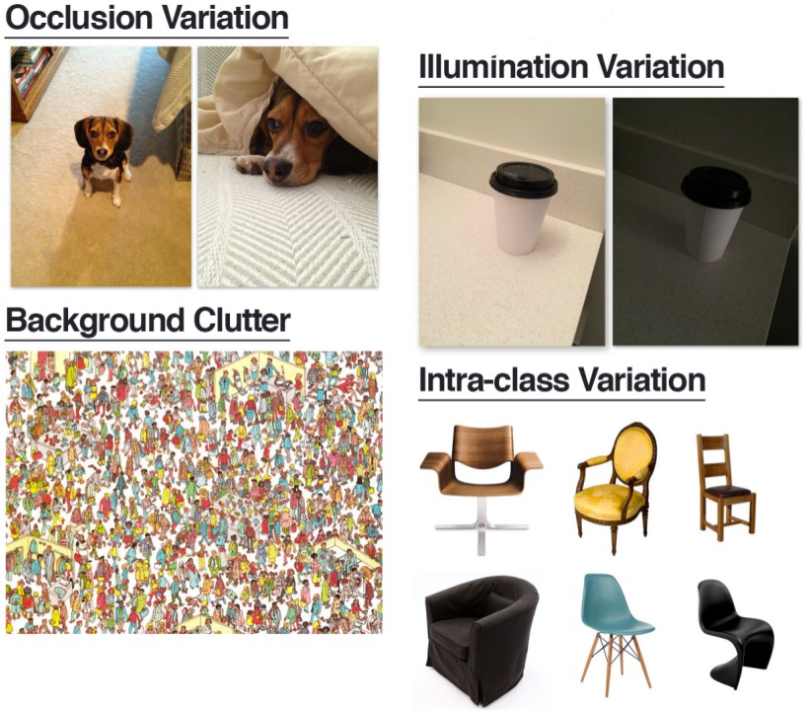
Image classification
Challenges
Intro to Mahcine Learning

Slide 15

Contents
1 Overview
2
Image Classification Terminology
3
Challenges
4 Deep learning classification pipeline
5
The four steps
Step 1: Gather Your Dataset Step 2: Split Your Dataset Step 3: Train your Network Step 4: Evaluate
6 Feature-based Learning versus Deep Learning
Intro to Mahcine Learning

Slide 16
Deep learning classification pipeline
The four steps of building a deep learning-based image classifier as well as compare and contrast traditional feature-based machine learning versus end-to-end deep learning.
Intro to Mahcine Learning

Slide 17
Deep learning classification pipeline
A shift in mindset
>>> def fib(n):
... if n == 0:
... return 0
... elif n == 1:
... return 1
... else:
... return fib(n-1) + fib(n-2)
... >>>
Intro to Mahcine Learning

Slide 18
Deep learning classification pipeline
A shift in mindset
Accepts an input, returns an output. The process is well defined.
The output is easily verifiable for correctness. Lends itself well to code coverage and test suites.
Unfortunately, this is not the case for deep learning and image classification!
Intro to Mahcine Learning

Slide 19
Deep learning classification pipeline
A shift in mindset
Now, imagine trying to write a procedural function that can not only tell the difference between these two photos of cat and dog.
How would you go about accomplishing this task? Would you check individual pixel values at various (x, y )-coordinates?
Write hundreds of if/else statements? And how would you maintain and verify the correctness of such as massive rule-based system?
The short answer is: you don’t.
Intro to Mahcine Learning

Slide 20

Contents
1 Overview
2
Image Classification Terminology
3
Challenges
4 Deep learning classification pipeline
5
The four steps
Step 1: Gather Your Dataset Step 2: Split Your Dataset Step 3: Train your Network Step 4: Evaluate
6 Feature-based Learning versus Deep Learning
Intro to Mahcine Learning

Slide 21
Contents
1 Overview
2
Image Classification Terminology
3
Challenges
4 Deep learning classification pipeline
5
The four steps
Step 1: Gather Your Dataset Step 2: Split Your Dataset Step 3: Train your Network Step 4: Evaluate
6 Feature-based Learning versus Deep Learning
Intro to Mahcine Learning

Slide 22
Deep learning classification pipeline
Step #1: Gather Your Dataset
If we have twice the number of cat images than dog images, and five times the number of panda images than cat images, then our classifier will become naturally biased to overfitting into these heavily-represented categories.
Class imbalance is a common problem in machine learning and there exist a number of ways to overcome it.
Intro to Mahcine Learning

Slide 23
Deep learning classification pipeline
Step #1: Gather Your Dataset (cont.)
If we have twice the number of cat images than dog images, and five times the number of panda images than cat images, then our classifier will become naturally biased to overfitting into these heavily-represented categories.
Class imbalance is a common problem in machine learning and there exist a number of ways to overcome it.
Intro to Mahcine Learning
21 / 33

Slide 24
Contents
1 Overview
2
Image Classification Terminology
3
Challenges
4 Deep learning classification pipeline
5
The four steps
Step 1: Gather Your Dataset Step 2: Split Your Dataset Step 3: Train your Network Step 4: Evaluate
6 Feature-based Learning versus Deep Learning
Intro to Mahcine Learning
21 / 33

Slide 25
Deep learning classification pipeline
Step #2: Split your dataset
Now that we have our initial dataset, we need to split it into two parts:
1
A training set A testing set
2
A training set is used by our classifier to “learn” what each category looks like by making predictions on the input data and then correct itself when predictions are wrong.
After the classifier has been trained, we can evaluate the performing on a testing set.
Intro to Mahcine Learning

Slide 26
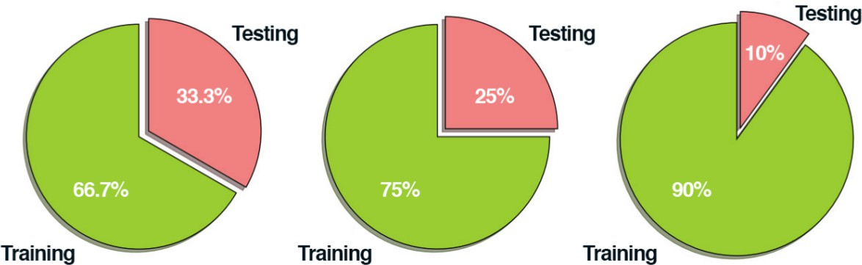
Deep learning classification pipeline
Step #2: Split your dataset (Precaution)
It’s extremely important that the training set and testing set are independent of each other and do not overlap! If you use your testing set as part of your training data, then your classifier has an unfair advantage since it has already seen the testing examples before and “learned” from them. Instead, you must keep this testing set entirely separate from your training process and use it only to evaluate your network.
Figure: Examples of common training and testing data splits.
Intro to Mahcine Learning

Slide 27
Deep learning classification pipeline
Step #2: Split your dataset (cont.)
These data splits make sense, but what if you have parameters to tune?
Neural networks have a number of knobs and levers (ex., learning rate, decay, regularization, etc.) that need to be tuned and dialed to obtain optimal performance. We’ll call these types of parameters hyperparameters, and it’s critical that they get set properly.
Intro to Mahcine Learning

Slide 28
Deep learning classification pipeline
Step #2: Split your dataset (cont.)
In practice, we need to test a bunch of these hyperparameters and identify the set of parameters that works the best.
You might be tempted to use your testing data to tweak these values, but again, this is a major no-no! The test set is only used in evaluating the performance of your network.
Intro to Mahcine Learning

Slide 29
Deep learning classification pipeline
Step #2: Split your dataset (cont.)
Validation set: Instead, you should create a third data split called the validation set. This set of the data (normally) comes from the training data and is used as “fake test data” so we can tune our hyperparameters. Only after have we determined the hyperparameter values using the validation set do we move on to collecting final accuracy results in the testing data.
We normally allocate roughly 10-20% of the training data for validation. If splitting your data into chunks sounds complicated, it’s actually not. As we’ll see in our next chapter, it’s quite simple and can be accomplished with only a single line of code thanks to the scikit-learn library.
Intro to Mahcine Learning
26 / 33

Slide 30
Contents
1 Overview
2
Image Classification Terminology
3
Challenges
4 Deep learning classification pipeline
5
The four steps
Step 1: Gather Your Dataset Step 2: Split Your Dataset Step 3: Train your Network Step 4: Evaluate
6 Feature-based Learning versus Deep Learning
Intro to Mahcine Learning
26 / 33

Slide 31
Deep learning classification pipeline
Step 3: Train your network.
Given our training set of images, we can now train our network. The goal here is for our network to learn how to recognize each of the categories in our labeled data. When the model makes a mistake, it learns from this mistake and improves itself.
Intro to Mahcine Learning
27 / 33

Slide 32
Contents
1 Overview
2
Image Classification Terminology
3
Challenges
4 Deep learning classification pipeline
5
The four steps
Step 1: Gather Your Dataset Step 2: Split Your Dataset Step 3: Train your Network Step 4: Evaluate
6 Feature-based Learning versus Deep Learning
Intro to Mahcine Learning
27 / 33

Slide 33
Deep learning classification pipeline
Step 4: Evaluate.
Last, we need to evaluate our trained network. For each of the images in our testing set, we present them to the network and ask it to predict what it thinks the label of the image is. We then tabulate the predictions of the model for an image in the testing set.
Finally, these model predictions are compared to the ground-truth labels from our testing set. The ground-truth labels represent what the image category actually is. From there, we can compute the number of predictions our classifier got correct and compute aggregate reports such as precision, recall, and f-measure, which are used to quantify the performance of our network as a whole.
Intro to Mahcine Learning

Slide 34

Contents
1 Overview
2
Image Classification Terminology
3
Challenges
4 Deep learning classification pipeline
5
The four steps
Step 1: Gather Your Dataset Step 2: Split Your Dataset Step 3: Train your Network Step 4: Evaluate
6 Feature-based Learning versus Deep Learning
Intro to Mahcine Learning

Slide 35
Feature-based Learning versus Deep Learning
In the traditional, feature-based approach to image classification, there is actually a step inserted between Step #2 and Step #3 – this step is feature extraction. During this phase, we apply hand-engineered algorithms such as HOG [32], LBPs [21], etc. to quantify the contents of an image based on a particular component of the image we want to encode (i.e., shape, color, texture). Given these features, we then proceed to train our classifier and evaluate it.
When building Convolutional Neural Networks, we can actually skip the feature extraction step. The reason for this is because CNNs are end-to-end models. We present the raw input data (pixels) to the network. The network then learns filters inside its hidden layers that can be used to discriminate amongst object classes. The output of the network is then a probability distribution over class labels.
Intro to Mahcine Learning

Slide 36
Feature-based Learning versus Deep Learning
One of the exciting aspects of using CNNs is that we no longer need to fuss over hand- engineered features – we can let our network learn the features instead. However, this tradeoff does come at a cost.
Training CNNs can be a non-trivial process, so be prepared to spend considerable time familiarizing yourself with the experience and running many experiments to determine what does and does not work.
Intro to Mahcine Learning

Slide 37
image classification
image classification is the task of assigning a label to an image from a predefined set of categories.
Intro to Mahcine Learning

Slide 38
The End
38 / 38

